Slide 1
Full Spectrum Security
from Lexmark
OPTIMIZE
MANAGE
STREAMLINE & SECURE

Slide 2
GDPR
Token (OAuth)
Multi-Factor
Mobile Authentication
Dashboards/Monitoring Systems
Vulnerabilities
End-to-end Solutions
Biometrics
USER IGNORANCE
Access Controls
Cloud
Data Privacy
Authentication
Certifications & Standards
Encryption
Smartcards
Sanitization/Overwrite
Integrity Checks
Role Based Authentication
Breaches
Notes:
Hello. I want to share with you how Lexmark is helping protect our clients against security threats involving output devices. Every day we hear about new vulnerabilities and breaches, usually after the damage has been done. And as we talk to our customers across a range of industries that we serve, security is always top of mind. Concerns range from protecting their customer, constituent, or patient’s information, proprietary knowledge, trade secrets, and compliance with regulatory processes.

Slide 3
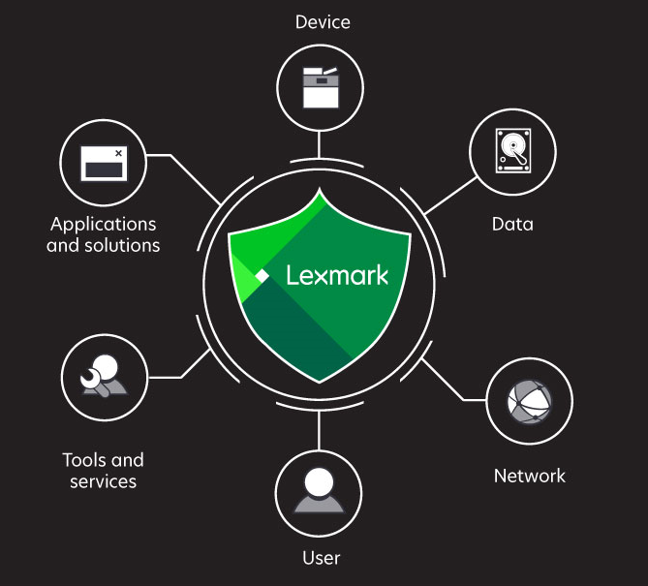
Our goal: Helping you achieve your security objectives
Notes:
Our goal is to help you achieve your security objectives across your entire printing infrastructure. From when the job is on it’s way to a device, while it’s is on the device, and when it’s headed to another electronic system.
When looking at your secure print environment, it is imperative that you:
Address the unique needs of your business areas and the employee that work in them
Your device’s and their firmware are easy to implement, maintain, and protected from both internal and external hackers and threats
You have alignment with your overall IT security and privacy goals as well as any third party or government certification or requirements
At Lexmark, we’ve been building security into each and every one of our devices for more than a decade and are confident that we can help you achieve your security objectives.

Slide 4
Unsecured print = Unsecured IT
1
80%
*
Profile of typical enterprise fleet
of organizations
Security policy in place
for accessing documents, along with
what and where information can be stored
54%
Devices 5+ years old
*
63%
of organizations
Security policy about what printers and MFPs
can be used to print, scan, fax or copy documents
52
Models
61%
**
6
of large enterprises
Manufacturers
Admitted suffering at least one data breach through insecure printing
Unsecured print = Unsecured IT
Bottom line:
*Based on results from IDC’s Print Security Survey, IDC #US40612015
**Quocirca 2017 report, Print security: An imperative of the IoT era
Notes:
A number of high-profile companies have been subject to hacks that resulted in financial losses in the hundreds of millions of dollars. For example, at Anthem and the US Government’s Office of Personnel Management alone over 100 million records were compromised. Studies show the average organizational cost of a data breach in the US last year was 6.5 million dollars.
Companies are painfully aware of and focused on security – in their devices, their fleets, and across their networks.
Let’s first look at two positive stats. 80% of organizations have a security policy in place for accessing documents. 63% of organizations also have a security policy about what printers and MFPs can be used for print, scan, fax, and copy. The problem with these stats is that we also see that 61% of large enterprises admit suffering at least one data breach involving print. Our devices can be configured to meet your IT Policies around print, but it’s critical that you maintain an up to date fleet and have a handle on which devices are where and what (if any) security vulnerabilities they might have.
Unsecured print = Unsecured IT

Slide 5
GDPR and print
By May 2018,
The GDPR requires that organizations that control or process
personal data of EU residents abide by six principles: lawfulness, fairness, transparency; purpose limitation; data minimization; accuracy; retention; integrity and confidentiality
Penalties:
Up to 20M € or
4% of revenue
Print related risks
Unrestricted access to print devices
Cyber-attacks on unprotected devices
Unprotected hard drives
Unclaimed documents
Notes:
Governments are also starting to take more interest in ensuring that organization’s IT networks are secure. In Europe, the General Data Protection Regulation, or “GDPR” will take effect in May of 2018. It will harmonize data privacy laws across Europe, to protect and empower all EU citizen’s data privacy and to reshape the way organizations across the region approach data privacy.
In short, your organization is required to do everything it can to protect your customer’s data – and that includes controlling access to printed documents and protecting everything that comes into, resides within, and is sent out of your print devices.

Slide 6
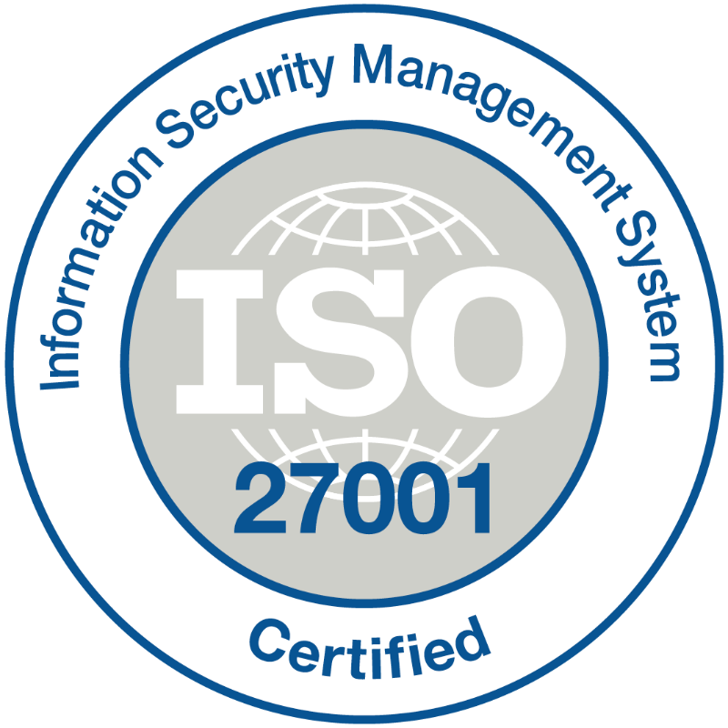
Exceeding strict compliance requirements
Information
Hardware
Standards
Information
Cyber Security
Notes:
Compliance with evolving regulations and requirements is an absolute necessity to reduce risk associated with the loss and / or theft of data. As government agencies and regulatory bodies create and evolve standards on how information is collected, processed and stored, companies are reexamining how they handle and store data and information.

Slide 7
Lexmark security leadership
Many vendors are announcing new security features
…but they’re not new to Lexmark
White Listing
Embedded Encrypted HDD
HDD Overwrite
Embedded Secure File Erase
Turn On/Off Remote Firmware Upgrade (RFU) on Device
Secure Boot with “Self-Healing”
Runtime Intrusion Detection
Embedded FIPS 140
Embedded NFC Hardware
Embedded WiFi Direct
Trusted Platform Module (TPM)
2005
2005
2005
2008
2008
2010
2010
2010
2012
2012
2016
Notes:
Fortunately, Lexmark can help.
Security around print devices has been receiving more and more attention recently and we’re proud to say that this isn’t new territory for us. We’ve been making security an integral part of our print devices for more than a decade and we have placements in some of the most secure military and intelligence agencies in the world.

Slide 8
Lexmark security spectrum
Security by design - complete security throughout and around the device and document
User authentication
Device management
Hard disk security
Secure output
Device protection
OS
Network protection
Solutions
Notes:
We view the our printers as much more than an output device. Security by design means “inclusion of data protection from the onset of the designing of systems, rather than an addition.”
We ensure that your organization’s print devices and hard copy documents are protected with a mountain of security features. Some of these include authenticating users with role base permissions, encrypting the device’s hard drives, locking down the ports so that outsiders can’t hack their way in, and with solutions that make sure that confidential print and copy jobs aren’t floating around and putting your organization at risk.
As security needs change in a customer’s environment, Lexmark is able to adapt our technology to meet their needs. We listen to our customers, as well as the market, to enhance and add functions to our Full Spectrum security.
Which of these are the top priority for you? If you’d like, we can drill down some more and give you some additional details.

Slide 9
Lexmark security - User authentication
Block, lock, and secure
User authentication
Badge access enabled
Login restrictions
Control panel lock
Privacy compliance
home
Notes:
If your devices are wide open, you’re just asking for trouble.
By authenticating users, you can “Lock, block, and secure” who has access to the documents that are waiting to be printed - as well as the security of the device itself. Lexmark can enable your employee ID badge to also grant you access to the device and can also restrict the permissions and features available on the control panel to employees based on their role or which department they belong to.
Protecting the privacy of the content that flows on or through your device is critical to maintaining compliance with government and industry standards, which when violated, can result in lawsuits and millions of dollars in fines.

Slide 10
Lexmark security - Hard disk security
Complete security throughout and around the device and document
Real time encryption
Device specific drives
Hard disk security
Automated wiping
Physically lockable
home
Notes:
Whether your printing, copying, or routing paper into other backend IT systems you must ensure that the content that goes on or through your device’s hard drive is completely secure.
With Lexmark, not only is all of the content of your job completely encrypted while in route to the device, when it reaches the device’s hard drive automated wiping immediately overwrites areas of the disk that were used for the job.
In addition, the hard drives are physically locked inside the device and and uniquely tagged so that even if someone was able to rip a hard drive out, they would not be able to plug it into another device or access what was on it.

Slide 11
Lexmark security - Device protection
Complete security throughout and around the device and document
Operating system security
Secure firmware updates
Audit logs to track usage
Device protection
OS
Continuous self-checking
home
Notes:
Device security should not be an afterthought or something that you should have to pay extra for. At Lexmark, protecting our devices is at the core of what we do.
We use what are called “Digital Signatures” to ensure that only authorized firmware can be installed on the device. We also create an audit log of every “Who, What, Where, and When” of any attempt to install or change the firmware. Our machines are continuously self-checking to ensure that the device is free of malware, viruses, or unauthorized firmware. If the device detects that its security is compromised, it immediately stops operation, does a “Golden reboot”…or restarts to the last know state of total security, and reports the error to authorized IT personnel.

Slide 12
Lexmark security - Device management
Complete security throughout and around the device and document
Device/fleet management
Device management
Asset management
Device configuration via Embedded Web Server
Genuine supplies
home
Notes:
We all know the convenience of everyone having their own personal printer sitting on their desk. In fact, we’ve found in some organizations that it’s actually a status symbol. However, that sea of detached, hidden, and unaccounted for devices poses not only a risk to your bottom line, but a risk in your overall IT strategy and security.
Lexmark offers the option of Managed Services to take the worry out of managing your devices. We can give you the tools to keep your fleet up to date with the latest firmware updates and security protection and ensure that your IT investments aren’t at risk with flimsy and unreliable 3rd party components or consumables.

Slide 13
Lexmark security - Secure output
Complete security throughout and around the device and document
Print release
Secure scanning
Secure printing
Secure output
Document auditing
home
Notes:
Have you ever walked up to a printer and found something laying there in a tray that probably shouldn’t be? Maybe it was a classified report, payroll information, or Doug from Accounting’s resume and cover letter for the job he’s applying for down the street. Have you ever printed something like that and had to run down the hallway to grab it off the tray before anyone got there first?
Lexmark’s print release solution allows you to swipe your ID badge and release a print job when you’re physically in front of the machine. In addition, you can choose to delete or allow to expire those jobs you printed by mistake.
Our secure scanning capabilities allows you to grant employees “scan-to” permissions based on their job or department - thus ensuring that other backend systems aren’t contaminated with confidential or simply irrelevant content.
Lastly, gain real insight into who is printing what, how often, and how much. Lexmark offers varying levels of auditing capabilities based on your organization's needs. Everything from identifying wasted resources all the way to capturing the actual images and content that is printed or scanned on your device. All configurable based on what you want to monitor.

Slide 14
Lexmark security - Network protection
Block, lock, and secure
Whitelisting
Port filtering
802.1x authentication
Network Time Protocol
Network protection
home
Notes:
Hardening a networked device is a powerful way to secure its interfaces from malicious users. This includes blocking unnecessary features and functions, locking down any interfaces that remain, and securing the
data hosted by the device. Lexmark devices include a range of features embedded in the firmware to help you harden the device.
[Definitions: if asked for more details]
Whitelisting: This blocks all TCP connections from other addresses, protecting the device against unauthorized printing and configuration. Lexmark devices support TCP connection filtering with the Restricted Server List field. By using this option, the device can accept
Port filtering: Port filtering on Lexmark devices acts as a granular filter, which you can use to disable network ports individually.
With port filtering, devices can be configured to comply with virtually any protocol network access policy.
802.1x authentication: It is important to require devices, such as laptops or MFPs, to be authenticated before they can access networks. The protocol for this authentication is called 802.1X.
Network Time Protocol: Network Time Protocol (NTP) provides devices with a common time source to keep them synchronized with the
correct date and time so they can successfully use any authentication method that requires accurate time. To
ensure that the date and time are being delivered only from an approved authenticated time source, Secure NTP is
also supported.

Slide 15
Lexmark security - Solutions
Complete security throughout and around the device and document
Print release
CAC/PIV card authentication
Secure Document Monitor
Classified Incident Reporting
Solutions
home
Notes:
Lexmark products support installable solutions that are written to utilize the Electronic Solutions Framework...or eSF…platforms in the device. These solutions extend the basic capabilities of the device, often enhancing the security of the device or the customer environment.
Hardcopy paper lying around on devices poses a major security threat and privacy violation. Have any of you ever walked up to a printer and found something lying on there that shouldn’t be? [Earnings forecast, patient/employee information, classified documents]. Or perhaps you’ve “hit print” yourself and then sprinted across the room in order to grab it off the printer before anyone else saw it.
Our print release solution ensures that your print jobs aren’t released until you get to the machine and release them yourself. And by integrating card authentication your organization can determine who has access to which devices and/or functions on those devices.
Some organizations process documents and information that are so sensitive that they need to be continuously monitored. With our Secure Document Monitor solution you can integrate your device with your Data Loss Prevention system and you can monitor who and what each employee is printing just as you might with email, web traffic, and desktop hard drive or network shared folders. For example, you could monitor for any printed or copied document that contains more than 5 social security numbers, or maybe you’ve got a secret team working on “Project Alpha” and you want to know if anyone outside of that team is copying documents about it. Or maybe you need to monitor the activities of an individual employee who is on a performance plan or acting suspiciously.
Some organizations print and copy such classified information that they have to run devices on two separate networks - a classified and an unclassified one. However, from time to time employees accidentally print or copy classified information on an unclassified devices. When this happens, employees are “supposed” report the incident to security personnel. However, often they don’t and as a result an even more time consuming and expensive investigation has to take place. Our Classified Incident Reporting solution allows employees to self-report when they’ve accidentally used an unclassified device for classified documents. They answer a few questions about the incident on Lexmark’s easy to use touch screen, the device sends an incident report to security personnel, and the device automatically disconnects itself from the network and takes itself out of commission.

Slide 16
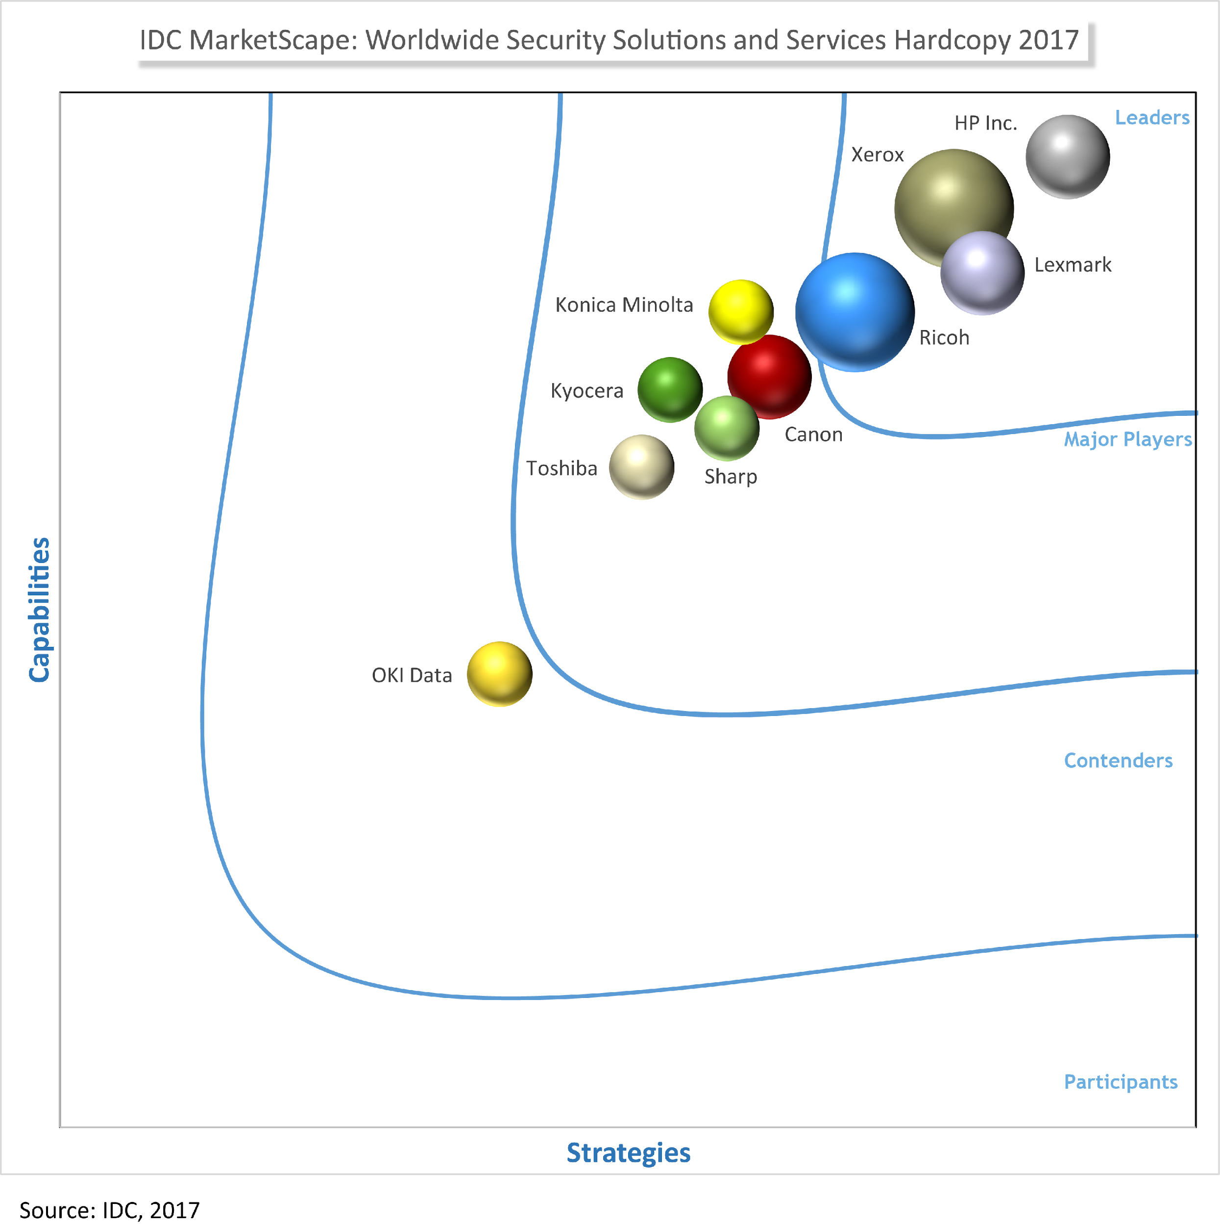
Recognized security leadership
...Lexmark's expansive security solutions portfolio and professional services expertise, puts Lexmark in a strong position for delivering best-in-class security for its customers.”
Robert Palmer
Research Director, Imaging, Printing, and Document Solutions
Notes:
Our approach to security has been validated by top analyst firm IDC – ranking us as a leader in security solutions and services.
We’re very proud of being recognized for our best-in-class security and our ability to pair that with our hands-on approach to creating customers for life with industry expertise and building relationship and addressing customer’s specific pain points and business needs.

Slide 17
Getting started – large account
Security consultation
Create an action plan
Implement
Where we go from here.
What do you think?
Notes:
As next steps, we’d like to sit down with you and dive more deeply into your specific security concerns, create an action plan on how to address those, and finally implement that plan that you can rest assured that your print network is secure

Slide 18
Getting started – channel partner
Talk to your customers about the need for print security
Identify organizations with and aged, mixed fleet
Engage Lexmark subject matter experts
Provide high value consult to your customers
Where we go from here.
What do you think?

